Slide 1
Using BRM for Business Case and Business Process Improvements and Budgeting
Concept Level
January 7, 2003
IAC EA SIG Draft – This is a work in progress

Slide 2
Agenda
Objective: Useful BRM..What needs to be Done Next
Challenges..
Agency/Customer Needs
Activities in each Step
Recommended Set of Changes
Issues not Addressed

Slide 3
Use of Business Reference Models and Business Process and Business Value: Critical Success Factors
Focus on Delivering one citizen segment or Business Line at a time
Do only those things that the government must-uniquely government or is “world class” in and find partners for everything else.
Align through interfaces, agreements, and business process standards adoption not specific applications and hardware.
After creating a library of Components and service interface we can integrated them together with Web Services choreography or the Business Process Management
Build your business vision from the top along each business line and the business cases that roll-up from the bottom.
Business Line Architecture Management must recognize the “soft” skills of change management involved with understanding, defining concrete targets, leveraging the skills of cross-organizational teams, and delivery consistent incremental value.
Business Line Architecture Management is transformation management and the implementation issues and “style” are as important as the technologies.
Technology rhetoric must be tested with proof-of-concept projects in the government environments and lessons learned must be shared. Enterprise Solution Integration Laboratory or “Infostructure” Competency Center.
Never get so deep that we forget why we are changing the process to provide increased service the citizens and not for our own functional reasons or to introduce new technologies.

Slide 4
Provide a Clear Guidance on Use of BRM: Eliminate the Clutter with Focus Recommendations
Used within your existing Department and Agency: 6 Step Process and Guidance with a Common Business Process Notation (BPMN with Government Extensions)
Move from Portfolio Managers to Business Line Facilitators and Business Line Communities and train many Sponsors and Leaders
Business Transformation Toolkit: Define, Acquire, and Use

Slide 5




Today’s Government Transformation projects need not repeat the mistakes of the early 1990s
Cost reduction is a good outcome but a poor objective- Value to Citizen and Collaboration across Business Lines are the Focus!
Acknowledge the central role of technology (and technologists) in process redesign but get the Business Folks Engaged!
Don’t confuse ignorance and arrogance with creativity- All ideas are worthy-Involvement is Key!

Slide 6
Linking Reference Models and Business Analysis Activities
Citizen- Business Community Feedback
Strategic Changes
Human Strategy: Change Impact
PRM
Business Models:
“as-is” & “to-be”
Performance Changes: Achievement Goals
BRM
Business
Cases
DRM
SCM
TRM

Slide 7
PRM-BRM Relationship Diagram
President’s Management Agenda
Strategic Plan
For
Business Line
PRM
Enterprise Architecture:Business Architecture- Process Models
Business Line
Architecture(s)
BRM
“As-Is”
Business
Models
“To-Be”
Business
Models
Strategic Scenario’s

Slide 8
Challenges Faced
BRM is new and how it relates to what has been done is not clear!
BRM is needed to support both the Enterprise Architecture and defining Cross-Government Business Line Architecture
Need concrete progress by the ’05 Budget- including submitting Joint A-11 300’s as well as stand-alone projects and programs
Must involve the Business Line Leaders and not just the IT Shop
Must represent not just the Administrative Functions but the key Mission elements of the organization
“Business Analysts” that are part of the Enterprise Architecture team do not have a common vocabulary and set of models
Business Case development is still a box check
Agencies focus on Outputs not Outcomes
Need to overcome Accountability and Traceability fears
Ties to the Strategy, IT-Capital Planning, and Budget Process must also be linked to the Performance Reference Model (PRM) and the GPRA/Performance Process

Slide 9
Agency/Customer Needs
During the Conceptual and Strategic Stages
During the Implementation and Deployment
During the Operational and Continuing Improvement Stages
Our Focus: Conceptual And Strategic Stages
Step 0: Context Review and “Schedule
The BRM activities are cyclical and will evolve probably with each years annual budget preparation and submission.
Work off material deficiencies with your EA process- October- January
Look for new guidance in January time frame
Look for cross-government partners…..

Slide 10
Business Line Architecture – Best Practices
Adapt practices from supply chain, demand analysis and trading community efforts along with research on Virtual Enterprises.
Focus on “people to people” defining and aligning around shared concepts, information that needs to be shared, with look at “end to end” information flow.
Virtual Communication Channels and Communities that form Virtual Enterprises based on “agreed” policies and principles.
Notes:
Define Common Business Goals
Agree on Core Concepts: Use Ideas from ebXML, UBL, UDEF, etc
Virtual Enterprise concepts and “readiness” for the Web services and Semantic Web activities

Slide 11
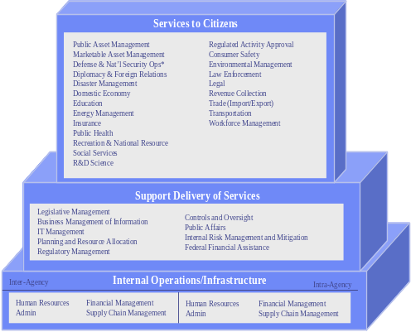
Using Business Reference Model: Conceptual and Strategic Stage
Strategy-Vision-
Concept of Operations
Services to Citizens
OMB BRM
Grants Research & Development
Education Loans
Legal
Financial Support Services
Business Process
Specification and
Design
Department
BRM
Support Delivery of Services
Federal Financial Service
Grants Assistance
Loans Assistance
Public Affairs
Internal Risk Mang.
Business Mang of Ingo
IT Management
Business Process
Improvements &
Achievement
Goals (PRM)
Internal Operations/Infrastructure
Business Line Channel discovery-commitment cycle
: G2G, G2B, G2E,G2C,IEE
Human Resources
Supply Chain Manag.
Administration
Resource Management
Business Case &
Budget Formulation
Business Line Channels:Lines of Business
Channel
1
Channel
2
Channel
3

Slide 12
Using Business Reference Model: Conceptual and Strategic Stage
0
1
Strategy-Vision-
Concept of Operations
3
Services to Citizens
Public Asset Management
Services to Citizens
Public Asset Management
Regulated Activity Approval
Marketable Asset Management
Regulated Activity Approval
Marketable Asset Management
Consumer Safety
Defense & Nat’l Security Ops*
Consumer Safety
Defense & Nat’l Security Ops*
Environmental Management
Diplomacy & Foreign Relations
Environmental Management
Diplomacy & Foreign Relations
Law Enforcement
Disaster Management
Law Enforcement
Disaster Management
Legal
Domestic Economy
Legal
Domestic Economy
Revenue Collection
Education
Revenue Collection
Map to OMB BRM
Education
Trade (Import/Export)
Energy Management
Trade (Import/Export)
Energy Management
Transportation
Insurance
Transportation
Insurance
Workforce Management
Public Health
Workforce Management
Public Health
Recreation & National Resource
Recreation & National Resource
Social Services
Social Services
Develop EA/BLA Annual Calendar
R&D Science
R&D Science
Start Now!!!
Support Delivery of Services
Legislative Management
Support Delivery of Services
Legislative Management
Controls and Oversight
Business Management of Information
Controls and Oversight
Business Management of Information
Public Affairs
IT Management
Public Affairs
4
IT Management
Internal Risk Management and Mitigation
Planning and Resource Allocation
Internal Risk Management and Mitigation
Planning and Resource Allocation
Federal Financial Assistance
Regulatory Management
Federal Financial Assistance
Regulatory Management
Internal Operations/Infrastructure
Inter
Internal Operations/Infrastructure
Inter
-
-
Agency
Agency
Intra
Intra
-
-
Agency
Human Resources
Agency
Services to Citizens
Human Resources
Financial Management
Financial Management
Human Resources
Human Resources
Financial Management
Admin
Financial Management
Admin
Supply Chain Management
Supply Chain Management
Admin
Admin
Supply Chain Management
Supply Chain Management
Grants Research & Development
Education Loans
Legal
Financial Support Services
Business Process
Specification and
Design
OMB BRM
2
Department
BRM
Support Delivery of Services
Federal Financial Service
Grants Assistance
Loans Assistance
Public Affairs
Internal Risk Mang.
Business Mang of Ingo
IT Management
Business Process
Improvements &
Achievement
Goals (PRM)
Internal Operations/Infrastructure
5
Business Line Channel discovery-commitment cycle
: G2G, G2B, G2E,G2C,IEE
Human Resources
Supply Chain Manag.
Administration
Resource Management
3
Business Case &
Budget Formulation
Business Line Channels:Lines of Business
Channel
1
Channel
2
Channel
3
6

Slide 13
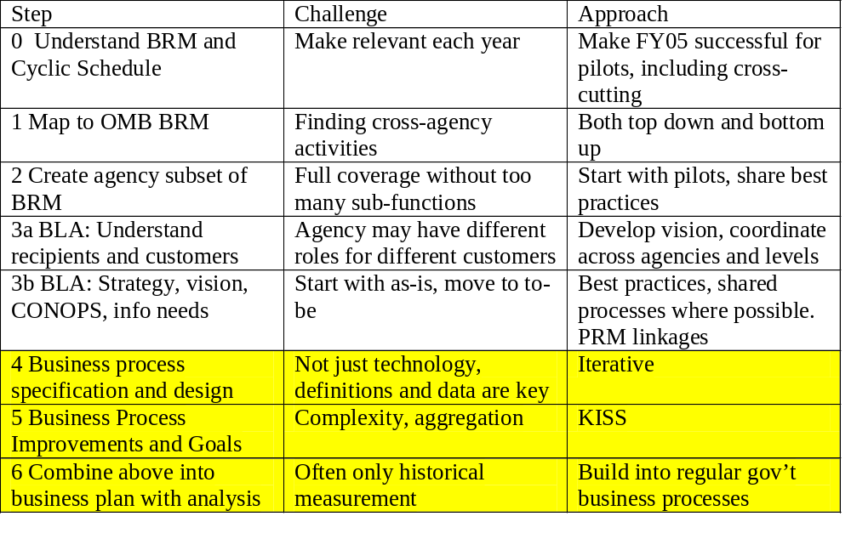
6 Step BRM Process
Repeat
Notes:
Define Common Business Goals
Agree on Core Concepts: Use Ideas from ebXML, UBL, UDEF, etc
Virtual Enterprise concepts and “readiness” for the Web services and Semantic Web activities

Slide 14





Business Line Linked to Access Channels
Steps
Understand Roles
Current Channel
Discover Opportunities
Define Obligations
Select and prioritize
BL Workshop
Agreements
Actions
Channel-
Description-
Opportunities-
Obligation-
“Joint
Commitments”
Department/Agency
Enterprise Architecture
Types of Channels: G2G, G2C, G2B, Topic Focused,..
Business Line
A: Lead
Responsibility
Business Line
B: Member
Responsibility
Business Line
C:
Context/Segment:
Responsibility
Business Line
D:
Context/Segment:
Responsibility
Business Line Channel Mappings
Business
Community
A
Business
Community
B
Business
Community
C
Business
Community
D

Slide 15
Concurrently Value-Driven Business Service Changes: Each Business Line and EA Effort must build upon those of other Reuse Top to Bottom
Repository and Reuse Must Start with Business Areas/Functions: Business Line
With Common Core Elements
BRM
PRM
BRM
Business Lines
Sub-functions
BRM
Security & Privacy Services
Business Line Architecture/Channels
SRM
Service
Layer 1
Functional Traceability
Contribution to Fulfillment
Service
Layer N
BRM
CBA
CBA
Layer 1
CBA
Layer M
Notes:
Evaluation criteria help to map back to performance criteria
Contribution to objective fulfillment at the component level
Services to the citizen
Kinds of components

Slide 16
Recommendations
Develop a Guidebook on Using BRM
FEA Focus on facilitating Business Line architectures.
Focus on Business Line Architectures: Portfolio Managers become Business Line Facilitators
  Define Business Line Workshop Process
  Define a Business Line Terminology based on Business Process Management Notation with Government Extension (Emerging Technology Subcommittee to Review and make recommended extensions)
  Business Line Tools, Collaboration-Partners Zone-Repository and Parametric and Systems Dynamics Forecaster Tools
Update FEAF to include FEA Reference Models and become Government Enterprise Architecture Framework(GEAF) to address business lines that link from Federal to State to Local with some international exchanges
Asses by maturity models that rate an agency on the extent of visibility and control in its supply chain and on its ability to customise its processes for each customer.

Slide 17

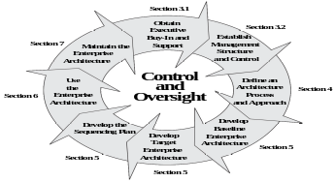
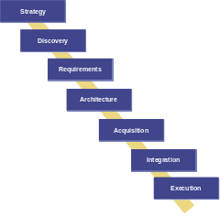
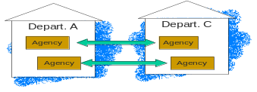
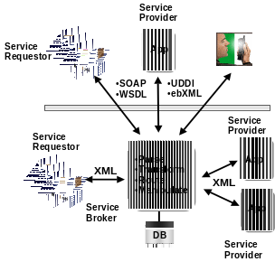
Recommendations for Business Process to Service to Component Architecture Transformation
“Portfolio Managers become
Business Line Facilitators”
Update EA with BRM & BLA
Process
Business Service Models
& Patterns
Manage BLA Changes
Business Analyst
Competency
Center
Update SDLC:
Business Driven
Interoperability
Define Business Process-
Notation and Language
Standards
Business
Analyst
Tool Kit- Portal
Notes:
Hit these briefly. Already talked about these above.
Revise EA Process to include cross-agency and cross-application factoring
Adopt a CBA-oriented SDLC
Adopt interoperability standards – Technical Reference Model
Develop a program to evaluate and acquire COTS/GOTS components
Institute a mechanism for development of cross-agency components
Adopt CBA infrastructure for development
Manage cultural change

Slide 18

Integrated Strategic BL- EA Management System
Logical Model
Department and Business Line Strategic Planning
External
Change-Impact
Analysis
Strategic
Plan
IT Capital
Plan
Strategic Outcomes
Business
Service
Models
Risk-Concern
Mgmt
Resource
Management
Strategic Changes
Repository &
I-TIPS
Business Line
Architecture
and Agreements
Business Line
Strategic Plan
&
Agreements
Business
Case
Development
Integrated
Governance
Business-
Change-EA Team
Business
Line
Continuous
Integration
Action Plans
Enterprise
Architecture Repository- EAMS
Principles-Decision
Framework
EA
Development
Opportunity
Identification-Analysis
Project
Formulation
System
BRM
Framework
Business-Performance
Management
PRM
Performance
Management
System
Collaborative
Zone
Program
Management

Slide 19
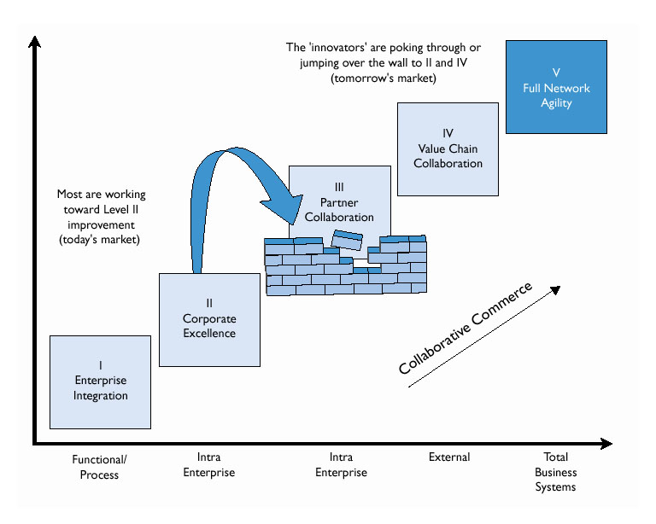
EA-BLA Challenges
Business
Service
Network
Early Business
Line Connections:
Prioritized- Service
Mainstream
BLA-Channels-
Service-Components
Program Focused
EA’s
Mission
EA/
“e-gov”
examples
Charles C. Poirier and Michael Bauer, E-Supply Chain, Berrett-Koehler Publishers, Inc, 2000.

Slide 20
Issues that Need to Be Addressed
EA/BLA activities need to be defined in FEAF 2.0 and Guidebook including such issues Business Design Change Management and Review Process including the Human, Organizational, Location, Data, etc and linked to Value-Driven Business Case
Extensive Outreach and Training needed
Phased approach starting with series of “Tactical” Projects Business Process Integration
Business Line “Terminology”: use some of the terminology from Business Process Management System, ebXML/BPSS, UBL, etc
Create Common Core- Universal Definitions for Business Process Terminology and Government Extensions.
  “Special Government” Terms may need to be defined
  Unique Per Business Line and Business Community
Look at UML 2.0/EDOC and Unified Enterprise Modeling Language (UEML)…etc..leverage and extend those ideas….RM-ODP- GERAM
Define an approach to extend for a Business Vocabulary for each Business Line and Community

Slide 21
Backup Charts

Slide 22
Overall Context Diagram: IAC Papers linked to FEA/RM and FEAF- IAC
EA
Governance &
Technology
Management
Model : Usage
Process Changes
BRM in Conceptual –Strategy Stage
Service Component Model
Cross-cutting Security
Architecture
Successful EA Activities
Framework
Human
EA Element
Reference Models:
RM to FEAF
Compatibility
Changes
Business
Business
Architecture
Information &
Data Reference
Model: Using
Federated
Approach
Transition
Architecture
FEAF
2.0
Information &
PLAN
Information &
Data Architecture
Data Architecture
Applications Architecture
Applications Architecture
Technology Architecture
Technology Architecture
Interfaces,
Interoperability,
Integration:
TRM
Mgmt
Security Service Framework
First
gov
Access Channels
Channel X: AAAA
PRM-Business Case
-Value
Channel
1: XXX
IT Investment
IT Investment
Management
Management
Management
Virtual Enterprises Connecting:
→
→
Goal Select
→
Plan
→
Select
Control
Business Segments
→
Change
Evaluate
Evaluate
Next Phase

Slide 23
The FEA Business Reference Model (BRM), Version 1.0
Government-
to-Citizen
Access Channels
Web
Services
Telephone
Voice
Interactive
E-system
to System
Public/Private
Partnerships
Face to
Face
Fax
Kiosk
Mail
Services to Citizens
Business Areas
Services to Citizens
Program Admin
Compliance
Program Admin
Compliance
Public Asset Management
Public Asset Management
Regulated Activity Approval
Lines of
Business
Marketable Asset Management
Regulated Activity Approval
Marketable Asset Management
Consumer Safety
Defense & Nat’l Security Ops
Consumer Safety
Defense & Nat’l Security Ops
Environmental Management
Diplomacy & Foreign Relations
Environmental Management
Diplomacy & Foreign Relations
Law Enforcement
Disaster Management
Law Enforcement
Internal
Disaster Management
Legal
Domestic Economy
Legal
Domestic Economy
Revenue Collection
Lines of Business
Education
Revenue Collection
Education
Trade (Import/Export)
Energy Management
Trade (Import/Export)
Energy Management
Transportation
Insurance
Transportation
Insurance
Workforce Management
Public Health
Workforce Management
Sub-Functions
Public Health
Recreation & National Resources
(pictured on following pages)
Recreation & National Resources
Employee-
to-Employee
Access Channels
Social Services
Social Services
R&D & Science
R&D & Science
Web
Services
Telephone
Voice
Interactive
E-system
to System
Public/Private
Partnerships
Face to
Face
Fax
Kiosk
Mail
Support Delivery of Services
Legislative Management
Business Management of Information
IT Management
Planning and Resource Allocation
Regulatory Management
Controls and Oversight
Public Affairs
Internal Risk Management and Mitigation
Federal Financial Assistance
Inter-Agency
Internal Operations / Infrastructure
Intra-Agency
Human Resources, Financial Management Admin Supply Chain Management
Human Resources, Financial Management Admin Supply Chain Management
Notes:
READ THROUGH THIS SLIDE AND USE WHITE BOARD TO DISCUSS THE THREE LEVEL FRA
WE HAVE PROPOSED SOME CHANGES TO THE ORIGINAL BUSINESS ARCHITECTURE . . . (next slide)

Slide 24
Other models build upon the BRM to define desired goals for the Government’s business lines and help agencies determine how to best allocate resources to meet those goals
Executive Input (GPRA)
DESIRED OUTCOMES
OUTCOMES
The Performance Reference Model
(PRM Effectiveness)
Citizen Service
Mission Performance
Internal efficiency
Common measures across agencies and programs
Web
Services
Telephone
Voice
Interactive
E-system
to System
Public/Private
Partnerships
Fax
Kiosk
Face to
Face
Mail
Services to Citizens
The Business Reference Model (BRM)
Program Admin
Compliance
Public Asset Management
Regulated Activity Approval
Marketable Asset Management
Consumer Safety
Defense & Nat’l Security Ops
Environmental Management
Programs tied to outcomes
Diplomacy & Foreign Relations
Law Enforcement
Disaster Management
Legal
Domestic Economy
Revenue Collection
Education
Trade (Import/Export)
BUSINESS NEEDS
Energy Management
Transportation
Insurance
Workforce Management
Public Health
Recreation & National Resources
Social Services
R&D & Science
Web
Services
Telephone
Voice
Interactive
E-system
to System
Public/Private
Partnerships
Fax
Kiosk
Face to
Face
Mail
Business support and administrative opportunities
Support Delivery of Services
Legislative Management
Controls and Oversight
Business Management of Information
Public Affairs
IT Management
Internal Risk Management and Mitigation
Planning and Resource Allocation
Federal Financial Assistance
Regulatory Management
Resource distribution
Inter
-
Agency
Internal Operations/Infrastructure
Intra
-
Agency
Human Resources Financial Management
Human Resources Financial Management
Admin Supply Chain Management
Admin Supply Chain Management
Resource reference models:
- Service Components
- Facilities
- Workforce, etc.
Information Technology
Human Capital
Other Capital Assets
PRM Efficiencies
RESOURCE ALLOCATION
Service Components,
Technology & Data
Workforce
Equipment,
Fleet &
Facilities
Notes:
READ THROUGH THIS SLIDE AND USE WHITE BOARD TO DISCUSS THE THREE LEVEL FRA
WE HAVE PROPOSED SOME CHANGES TO THE ORIGINAL BUSINESS ARCHITECTURE . . . (next slide)

Slide 25
The FEA reference models can be easily integrated along business lines, providing a foundation for Component-Based Architecture design
Performance Reference Model (PRM)
Outputs and Outcomes
Business
Reference Model
( BRM )
Service Component
Reference Model
( SRM )
Technical
Reference Model
( TRM )
Support Delivery
of Services
Rule Publication
Content
Management
Knowledge Management
CRM
PRM
Content Management
Collaboration
Search
Reporting
Platforms and OS
J2EE
.NET
Windows NT
Regulatory Management
Policy and Guidance Devel.
Public Comment Tracking
Regulatory Development
Rule Publication
Data Mgmt
ODBC
JDBC
Business Logic
Component-Based Architecture
Enterprise Products
Functional Products
Services

Slide 26
Using the Performance Reference Model, agencies will define performance measures and outcomes for Lines of Business -facilitating cross-agency, budget and performance integration
What business area
do I need to define?
What FEA Lines of Business support this business area?
What Performance Measures can be defined for these Lines of Business?
What Initiatives support these Performance Measures?
What Agency is is responsible for this initiative?
OHS
BUSINESS AREAS
LINES OF BUSINESS
Performance Measures
Initiatives
Agency
Conceptual
Border Control
Frequency of
Terrorist Events
Automated
Commercial Environment
Justice
Border and Transportation Security
Intelligence
Gathering
FEMA
Border Arrests
ATLAS
Coast Guard
Weapons Control
Transportation
Chemical, Biological, Radiological, and Nuclear Countermeasures
Customs Arrests
Deepwater
Air
Transportation
Automated Export
Trade Stats System
Commerce
Substance Abuse
Rates
Defense
Land
Transportation
Energy
Information Analysis and Infrastructure Protection
NICS
Maritime
Transportation
Number of
Illegally
Imported
Weapons
Treasury
Firearms
Integrated
Technology
Emergency Preparedness and Response
Number of Illegal Aliens
OHS EA
FEA BRM
FEA PRM
OHS Initiatives
Supporting
Agencies

Slide 27
The FEA Business Reference Model (BRM) defined …
The FEA BRM is a function-driven framework for describing the Lines of Business performed by the Federal Government independent of the Agencies that perform them
Notes:
The Business Reference Model (or Business Architecture) is the foundation of the entire Federal Architecture effort.
There are many “reference models” that one could use to describe a business
Org Chart
Location Chart
Etc.
For the FEA effort, we selected a Functional Hierarchy to describe the business of the US govt. WHY???
Identifies organizational stovepipes
Hierarchical construct allows different audiences to work at different levels (high level analysis vs. detailed process modeling)
Provides a great framework for describing the application, data and technology layers of the EA . . . WHICH BRINGS US TO OUR NEXT SLIDE . . .

Slide 28
The BRM has benefits for the overall Federal EA effort, the OMB E-Gov PMO, and the individual agencies…
The Business Reference Model:
Provides a foundation from which the other layers of the Federal Enterprise Architecture can be developed
Provides a common understanding of the Government’s business functions for agencies, oversight bodies, IT decision makers, and other stakeholders
Facilitates the identification of cross-agency opportunities and redundancies
Provides a valuable information resource and repository for the 24 Presidential Priority E-Gov Initiatives
Provides a common lexicon for comparing baseline and target IT environments, thereby facilitating the identification of a transition plan
Allows for a rapid assembly of business functions to support new and enhanced lines of business
Notes:
We just mentioned some of the benefits of the BRM we chose for the FEA effort, here are some more specific benefits:
Just read through these bullets . . . They should all be self-explanatory
Next slide : METHODOLOGY FOR BRM DEVELOPMENT

Slide 29
The FEA team employed a sound methodology in developing the BRM and leveraged previous efforts…
Use eGov Task Force LOB’s as default FEA BRM
Leverage Previous Efforts
Identify Sub-Functions for each LOB using various Agency information resources
Identify next level of the BRM
Map Agencies to LOB’s and Sub-Functions
Define LOBs and Sub-Functions
Define terms
Refine eGov Task Force LOB using Sub-Function analysis and EA best practices
Analyze & Refine
Release 1 Finalized
Plan for Continuous Improvement
FEA Business Reference Model
Notes:
The first step in the above slide is perhaps the most important:
LEVERAGED PREVIOUS EFFORTS
We drew from the business architecture designed as a part of the Quicksilver effort. Great thought had been put into its development, we knew we needed to leverage this
Next, we increased the granularity of the model by identifying Sub-Functions
Analyzed Agency EA’s, Web Sites, Strategic Plans, etc. and developed a long list of Candidate sub-Functions
Normalized the list to reduce the number of Sub-Functions. The identification of Sub-Functions helped us identify some gaps and redundancies in the original model (see final step).
Next, we mapped Agency’s to the Lines of Business and Sub-Functions
Next, we documented the definitions for all of these terms. This was an arduous but very necessary step.
Finally, we drew upon the information gathered in the previous steps, and revised the original model.
…THE PROPOSED BRM HAS THREE LEVELS … Next slide and go to board.

Slide 30
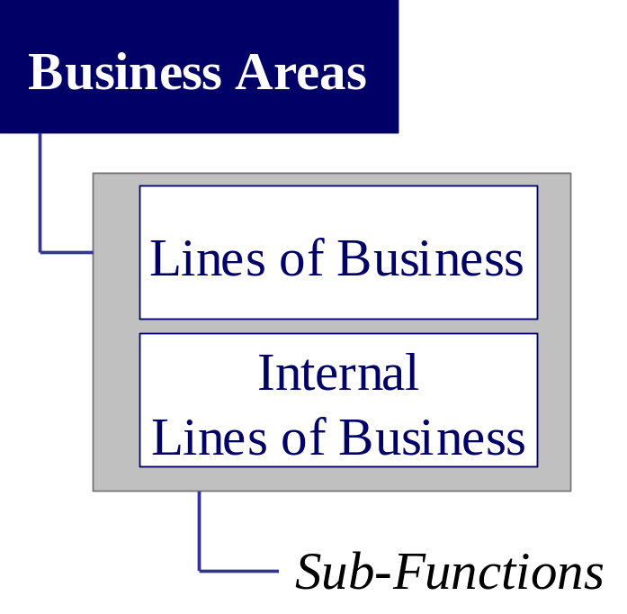
The FEA Business Reference Model is organized as a functional hierarchy with Business Areas at the highest level followed by Lines of Business and Business Sub-Functions
Three Business Areas provide a high-level view of the types of operations the Federal Government performs.
The three Business Areas decompose into two sub-areas and 35 Lines of Business and Internal Lines of Business. These Lines of Business describe more specifically the services and products the Government provides to its stakeholders, while the Internal Lines of Business describe the inter- and intra-Agency back office and support activities that enable the Government to operate.
There are 137 Sub-Functions which form the final level of decomposition within the FEA BRM and communicate the specific activities that Federal Agencies perform within each Line of Business and Internal Function.
INCREASED GRANULARITY AND DETAIL
Notes:
READ THROUGH THIS SLIDE AND USE WHITE BOARD TO DISCUSS THE THREE LEVEL FRA
WE HAVE PROPOSED SOME CHANGES TO THE ORIGINAL BUSINESS ARCHITECTURE . . . (next slide)

Slide 31
The FEA Business Reference Model (BRM), Version 1.0
Government-
to-Citizen
Access Channels
Web
Services
Telephone
Voice
Interactive
E-system
to System
Public/Private
Partnerships
Face to
Face
Fax
Kiosk
Mail
Services to Citizens
Business Areas
Services to Citizens
Program Admin
Compliance
Program Admin
Compliance
Public Asset Management
Public Asset Management
Regulated Activity Approval
Lines of
Business
Marketable Asset Management
Regulated Activity Approval
Marketable Asset Management
Consumer Safety
Defense & Nat’l Security Ops
Consumer Safety
Defense & Nat’l Security Ops
Environmental Management
Diplomacy & Foreign Relations
Environmental Management
Diplomacy & Foreign Relations
Law Enforcement
Disaster Management
Law Enforcement
Internal
Disaster Management
Legal
Domestic Economy
Legal
Domestic Economy
Revenue Collection
Lines of Business
Education
Revenue Collection
Education
Trade (Import/Export)
Energy Management
Trade (Import/Export)
Energy Management
Transportation
Insurance
Transportation
Insurance
Workforce Management
Public Health
Workforce Management
Sub-Functions
Public Health
Recreation & National Resources
(pictured on following pages)
Recreation & National Resources
Employee-
to-Employee
Access Channels
Social Services
Social Services
R&D & Science
R&D & Science
Web
Services
Telephone
Voice
Interactive
E-system
to System
Public/Private
Partnerships
Face to
Face
Fax
Kiosk
Mail
Support Delivery of Services
Legislative Management
Business Management of Information
IT Management
Planning and Resource Allocation
Regulatory Management
Controls and Oversight
Public Affairs
Internal Risk Management and Mitigation
Federal Financial Assistance
Inter-Agency
Internal Operations / Infrastructure
Intra-Agency
Human Resources, Financial Management Admin Supply Chain Management
Human Resources, Financial Management Admin Supply Chain Management
Notes:
READ THROUGH THIS SLIDE AND USE WHITE BOARD TO DISCUSS THE THREE LEVEL FRA
WE HAVE PROPOSED SOME CHANGES TO THE ORIGINAL BUSINESS ARCHITECTURE . . . (next slide)

Slide 32
Step 1: Mapping to OMB BRM
Where does your Department or Agency or e-gov project fall within the BRM?
Some of your elements will be part of an overall Business Line that crosses many organizations.
Take both a “Enterprise Architecture” perspective: top-to bottom within the Department –Agencies
But also take a business line perspective and look at which Business Lines you contribute: Department of Education may have the lead in Education but the Administration for Children and Families and their Head Start program
Business Line is made up of Series of “Business Segments” that are linked by a set of Access Channels-”Virtual Communication Channels” that are connecting to other members of the Business Community.
Each Business Line area can have a Business Topic Map of the terminology related to that “business area”

Slide 33
Step 2: Create Department/Agency BRM
Create “Wedding Cake” like diagram… that represents the Mission of the Department and the agency as a subset of OMB’s general BRM
Keep the number of Business Functions Small(if possible)….this will be difficult with large Federated Departments
Federated Agencies: Series of BRM “components or crosscuts of OMB general BRM that are integrated via Business Line Channels

Slide 34
Step 3a: Business Line Definition, Business Line Channel and Business Line Channel Opportunity Analysis
Business Line Strategic Planning: FEA-PMO Business Line Architects/Facilitators:Take each of the 35 business lines(prioritize), find stakeholders, present “mission” and initial opportunity for alignment, improvement and improved “Mission Delivery”, identify the key stakeholders and plan a Business Line Definition Workshop.
Conduct a Business Line Definition Workshop-I- agree on the “stakeholders” citizens supported, what “do they want”, listen to successes(success reports generated) and good things going on that can be “leveraged”, which other agencies-states-partners do you interact with- Business Information Flow- fragments(not a complete map-yet), where are gaps and known problems, brainstorm on short term fixes, and long term improvements, why won’t this work,…..
Reconvene and Review and Move Forward: Business Line Definition Workshop- II: Business Line Community Charter and Vision. Leverage and reuse success stories.
Define a Business Line Conceptual Model with “end to end” elements that cross the boundaries. Create a series of business models, services, and component maps.
Business Line Channel definitions: Current- not just the Computer interfaces but the types of communication
  Government to Citizen
  Government to Government
  Government to Business
  Government to Employees
  List of Events(Triggers) and the expected outcomes/results for each path
  Constraints and Opportunities for Improvement
Define the Business Segment Responsibilities and who will “lead” and sponsor changes. Sponsors are “SES” level and Leaders are from
Define Sponsorship and ask for “leaders” from members of the Business Line Community
Define a set of Ports and Channels within Cross-Government set of Access Channels: Create an Business Line Channel Map

Slide 35
Business Line Architecture and Blueprint Planning
Business Line
Strategic Planning
Pre-Workshop
Business Line
Analysis
Business Line
Workshop I:
Context-Vision-
Leverage Points
Business
Line
Collaborative
Zone
Toolkit
&
Repository
Lines of Business:
Homeland Security
Public Asset Management
Marketable Asset Management
Defense & Nat’l Security Ops
Diplomacy & Foreign Relations
Disaster Management
Domestic Economy
Education
Energy Management
Insurance
Public Health
Recreation & Natural Resource
Social Services
R&D Sciences
Others
Regulated Activity Approach
Consumer Safety
Environmental Management
Law Enforcement
Legal
Revenue Collection
Trade (Import/Export)
Transportation
Workforce Management
Asset Management
Public Asset Management
Public Asset Management
Business Line
Workshop II:
BPM. Channels,
Roles-Actions
Related Partner:
Activities: Networks,
Standards, etc
Business Line
Board: Success,
Mini-Business Cass,
Full Business Cases

Slide 36
Business Line Architecture:Business Services for Value Achievement integrating Government Services Providers: SBA One Stop Example
Service Value Network (SVN)
Business Line Architecture with Outcomes:
Targeted Customers: Small Business
Business Line Leader: SBA
Business Compliance One Stop
Service Provider: Business Community:Federal, State, Local
Outcome: Reduce Cost, improved access, etc
State(s)
Small Business
SBA: One Stop
Local
Government
Federal agencies
Information
Services
Discover
Needs
v
Evaluation &
Feedback
Outcomes
Small Business
Owner
v
v
v
v
Combine
Needs
v
Business Line:
Federated Service-Information
Integration Plan
Explore Options
Application
Completion
v
v
v
Functional
Services

Slide 37
Step 3b: Strategy, Vision, Operations Concepts, Information Needs
For each major business line the business line leader and those within the Business Community will develop a “future-oriented” Vision statement and Operations Concept along with a series of Business Processes as Services that will be grouped in “Contexts” and Segments that one of more business goals.
Services and Outcomes of each of the Business Process “Contexts” grouped into Segments will be shown in a series of diagrams: “Cartoon” and Business Process Activity Diagrams(Swim-Lane Diagrams)
  Business “cartoon” diagrams…….can be used to talk through the concepts
  Business Process Activity Diagrams will be used for explicit process specifications
Mapping the Current “As-is” and “Defining and making Trade-offs” of the Business Process in the future state will take “Strategic Business Line” Planning and Negotiation.
Strategic Value Changes for each of the PRM areas can be organized into a Strategic Map
Information Maps and Integration Maps are developed at a very high level- agreements have to be reached with the Business Community.
Set of Information Architecture and Interoperability elements have to “shared”
Service Interfaces- Integration Interfaces are needed….
Roles of the key players will be defined along with their association and relationship with each other: Human elements will be considered along with the required knowledge and skills
Performance and Value Results will be considered including establishing new “Achievement Goals” and other “maintenance goals”(For more detail see the PRM….paper/presentation)
Notes:
Business Process Differences List is created to show the “changes”
expected- increased automation, faster delivery, improvement quality,
……..Value Propositions
Simulation Models
Cost-Budget Estimates
Agreements at a high level will result

Slide 38
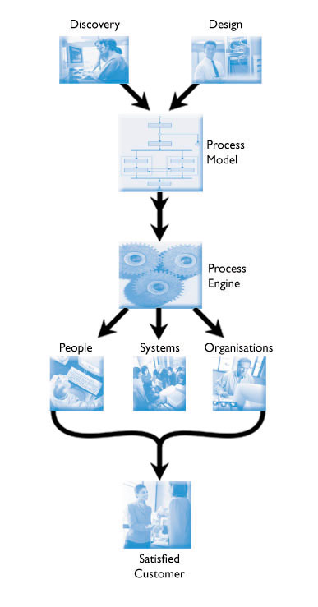
Approach to Creating Business Process Models and Making Operational

Slide 39
Step 4: Business Process Specification and Design
Multiple Levels of Business Models: Specification Level, Design, to Operational Realization
Abstract levels provide only the essential characteristics of the modeled world- the context selected. Everything else is suppressed.
These essential characteristics are formulated using a small set of concepts.
The essential “business rules” of the modeled situation are formulated as properties of the constructs used in the model.
But things are Complex- these simplified models help manage that complexity. Define the essential not the “ephemeral”. Abstraction takes stepping back.
A good model of a business serves as a framework for making decisions about possible future direction of this portion of the business.
Mathematical patterns or graphical patterns – can define the essential fragments that often are used in a variety of business areas.
Look for commonalities among apparently different kinds of business.
Business Environment and the expectations are one of the “insights” that can be gained in the process.

Slide 40

Business Process- Context Linked to Information and Data Needs
Small Business One Stop
Small Business Owner
Feedback and Immediate Evaluation
Identification &
Planned
Delivery of Info &
Functions
Application
Filled &
Submitted
Discovery of
Service Needs
Service
Offerings
Descriptions
Service
Process &
Plans
Service
Fulfillment

Slide 41
Emerging Technologies must Map to EA/BLA Elements: “Neat” technologies must Fit!- Everyone can’t do all the Investigation!
Emerging Technology Planning, Analysis and Piloting: Focus on “Opportunities”
From the Technology-Translate to Process with People
Defining Gov Process
Virtual
Channels,
SOAP,
MPLS
CDF, etc
Business
Process Management Language, Notation, UBL….
BRM
BRM
Business Lines
Sub-functions
Gov
Terms-Symbols
BRM
Security & Privacy Services
Business Line Architecture/Channels
SRM
Service
Layer 1
Web Services
Service
GRID
Patterns
Libraries
Functional Traceability
Contribution to Fulfillment
Service
Layer N
Security Services and Privacy
Integrated into
All EA elements
BRM
CBA
CBA
Layer 1
CBA
Layer M
Notes:
Evaluation criteria help to map back to performance criteria
Contribution to objective fulfillment at the component level
Services to the citizen
Kinds of components

Slide 42
OMB’s New SDLC Incorporates CBA in an Iterative Process
Business
Line
Architecture:
BPM to
Services
To
Stakeholders-
“Business
Service
Patterns”
Strategy
◆ Performance Measures, Objectives, Outcomes (PRM)
◆ Business Objectives (BRM)
◆ Funding, Partnering Strategies
Understanding the
Business
Discovery
◆ Identify Best Practices, technology Enablers, and Components
◆ Existing Stake Holders, Business Processes, and Workflows
◆ Existing Delivery and Access Channels (Portfolio)
Knowing What’s
Possible
Requirements
◆ Must Have Functions, Features, and Info Exchanges
◆ Short and Long-Term Requirements
◆ Assessment of As-is state: Gap analysis
Model the Business
Define the Gaps
Architecture
◆ Define Component Relationships to BRM
◆ Wiring & Activity Diagrams, Component Arch, Data Arch
◆ To-Be architecture ‘blueprints’
Develop the
“Blueprints”
Acquisition
◆ Define/Align Service Components
◆ Component Common Criteria, SLA
◆ Select COTS based on normalized EA vendor submissions.
Obtain Components
Integration
◆ Prototype Solution Architecture
◆ Verify ROI, business fit
◆ Validate Sequencing Plan
Assemble the
Components
Execution
◆ Deploy
◆ Manage
◆ re-Baseline
Execute &
Deploy
Iterative Development
Value-Based Releases
Artifacts and Activities

Slide 43
Repository: Sharing & Managing Software Assets- Must Go Beyond Software to Business & Service Assets
Application Development Group
Build
Specify
Find
Publish
Productize
Evaluate
Consume
User View
Agency Specific Catalog
Publish
Component Repository
Federal-Wide Catalog
Commercial Catalog
Notes:
Repository should provide common view to architect: candidate components that meet the search criteria can come from agency, federal or commercial sources.
Repository should also be able to manage the inventory of component licenses.
Certification is important (like Underwriters Laboratory seal)

Slide 44
Step 5: Business Process Improvements &Achievement
Goals (PRM): Use Simple Performance Models and gather results with Templates
Performance Planning with Business Analysis must be something that is done throughout the government
There maybe specialist and some contractors
But it must become a “core competency” of the government on how to deliver “Service to the Citizen” with a high performing process
Tools must be available:
  Simple Set of Parametric Modeling(spreadsheet tools) with System Dynamics must be available for “What-if” Analysis: Not just big Business Cases but many-many “mini” business cases
  Extensive training with these simple tools for many to use- Situation Specific Spreadsheets: COCOMO and COCOTS in Software Engineering and Expert Choice, Stella, etc can be put into Tools Environment

Slide 45
Step 5: Business Process Improvements & Achievement
Goals (PRM): (cont.)
Take the Quantitative output of the Business Cases and apply PRM Template to generate:
  Effective measures (Outputs)
  Efficient measures (Outputs)
  EVM Calculations
  Business Activity Analysis
  E-Gov Performance
Build SES Performance Balanced Scorecard
  Create Manager’s Performance Criteria
  Security, and other focus points (GISRA)
Redirect PRM Template output to Financial Management System for:
  Business Analytics
  Budget Submission
  Audit Criteria
PMO usage
  EVM
  Resource balance
  Inter Agency
CIO usage
  Infrastructure Performance
  EA Compliance

Slide 46

Performance Management System Integrates with Enterprise Architecture
Executive Management
Strategic Plan
Performance
Metrics
Performance
Management System
Business
Capital
Planning
Program Operations and
Compliance
Application
Data
Technology
GAO ITM Level 3
Human Capital
Enterprise Architecture
Budget $$$$

Slide 47
Step 6: Business Case & Budget Formulation
A “series” of opportunities for improvements can be defined by changing looking at the Business Process for business structure issues- “poor patterns” and replacing with improved business patterns.
  Changing the “gaps” in communication, forming new composition approaches, creating new relationships with members of the “community”….etc, etc…
  Many other improvements are usually defined by the Subject Matter Experts
Build A!!-300 Compliant Business Cases
  Risk Management
  Portfolio Analysis
  Value focused
Business Value Analysis for the Business Line that you lead and contribute to other business lines
Summarize Basic Business Case process- (Use Debra Stouffer’s slides from GCN EA conference and tool….talk about different order and the use of the spreadsheet tool….)
Special Business Case elements that need to be addressed include:
  The Security business case must match accurate estimates of development and operational costs against good estimates of the costs of intrusion over the life of the “extended enterprise”, project,….
  A Template could be produced that provides the security goals- includes a series of questions, and develops metrics and alternative approaches:
    What does the down time cost?
    What doe we lose when attacked and compromised?
    How do we measure the loss of revenue, impact of no service support, and reputation?
    Budget for prosecuting attackers or defending against irate customers?
    How much would an incident response cost?
    The expense to repair our application?
    Is there are commonly used checklist
    Create a security cost of ownership
  Component Reuse Business Case information
    Use of COCOTS tool or other reuse parametric estimation

Slide 48


Small Business One-Stop
Web services
Web services Integration Platform
Business
Document
Document
Processing
Execution
Engine
Legacy
Service Oriented
Interfaces
Adapters
XML
Message
Simple
Web service
COTS
Database
Combined
Business
Processes
Portal
And Display
Services
Service
Definition
Descriptions
Application Server Platform
Other
Devices
GUI Interfaces

Slide 49
Using BRM to Focus on Services to Citizen: BLA
BRM/BLA Guide
Facilitated Workshops- HLS & “Volunteers”
BPM Model-Vocabulary
HLS- Repository Plus “Volunteers”
HLS-”Infostructure” Center
e-gov projects packaged around services
FEA
2003
FY’2005:
Budget-BL
Business
Case Support
Planning BLA:BP-Web Services Readiness Stage
Each Organization can’t move ahead with
EA maturity by Itself. Must Reuse, Leverage, Cross Train…….
Commonality and Consistency require Focused investments…….
FEA
2004
FY’2005:
Business Lines:
Service Integration
Identify
Clear
Successes

